Slide 1
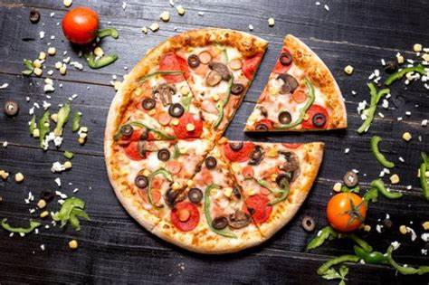
Pizza Sales Analysis Using SQL Server
Deepak Kumar

Slide 2
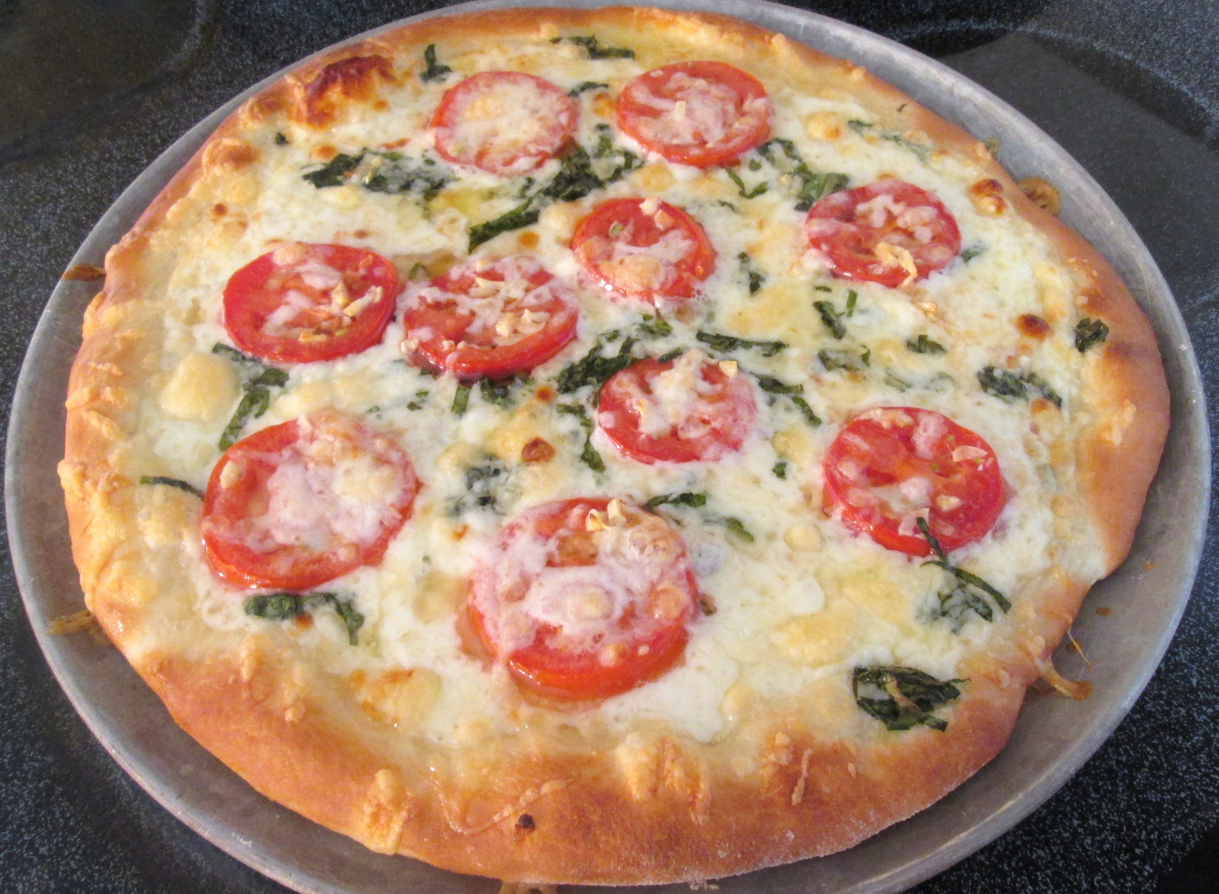
Project Overview
Project Overview: This SQL project revolves around a database schema designed to manage and nalyze data for a pizza store. The database consists of four primary tables: order_details, pizzas, orders, and pizza_types. Each table plays a crucial role in storing different facets of the business operations, from individual orders to the types of pizzas offered. Below is a detailed description of each table and its columns:

Slide 3
About Data Set
The raw data for this project is presented in 4 CSV files. This data represents a year’s worth of sales for a pizza outlet, and they need to answer a few questions which will help them make important decisions to increase sales and improve their business.
The project is done in Microsoft SQL server and presented in Power BI. The data was loaded into 4 tables. This project involves the use of simple joins and sub-queries.

Slide 4
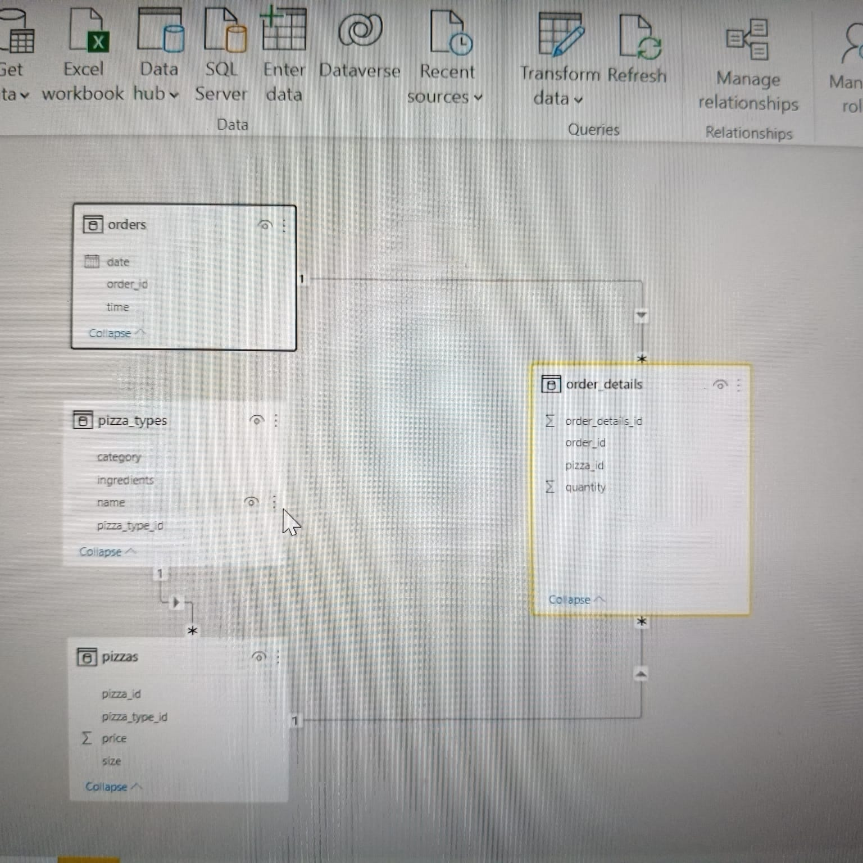
Relationship

Slide 5
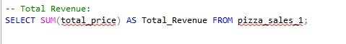
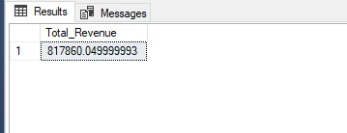
1. Total Revenue:
Query
Visual
Output
Insight:
Total Revenue for the year was $817,860

Slide 6
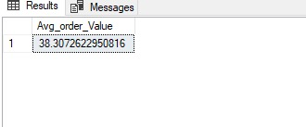
2. Average Order Values
Query
Visual
Output
Insight:
Average Order Value was $38.31

Slide 7
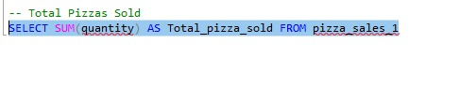
3. Total Pizza Sold
Query
Visual
Output
Insight:
Total Pizzas Sold – 50,000

Slide 8
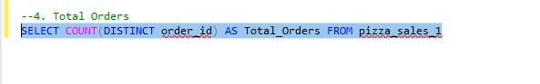
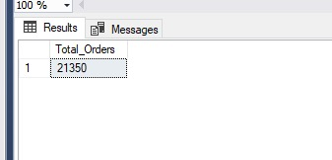
4. Total Orders
Query
Visual
Output
Insight:
Total Orders – 21,000

Slide 9
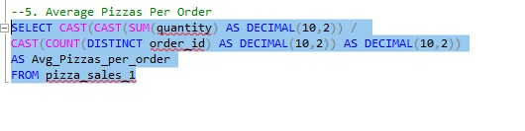
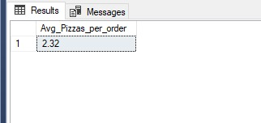
5. Average Pizza Per Order
Query
Visual
Output
Insight:
Average Pizzas per Order – 2

Slide 10
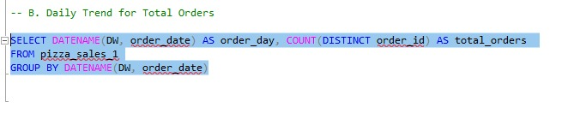
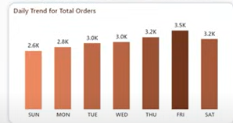
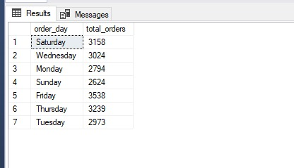
6. Daily Trend for Total Orders
Query
Visual
Output
Insight:
This visual is a bar chart titled "Daily Trend for Total Orders" that displays the total number of orders received each day of the week.
Trend Overview:
Friday has the highest number of orders at 3.5K.
Sunday has the lowest number of orders at 2.6K.
Weekday Patterns:
The middle of the week (Tuesday and Wednesday) maintains a steady order count at 3.0K.
There is a noticeable rise in orders starting Thursday, peaking on Friday
Weekend Patterns
Orders decrease slightly on Saturday compared to Friday but are still higher than the beginning of the week

Slide 11
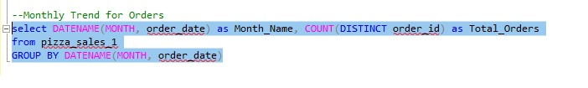
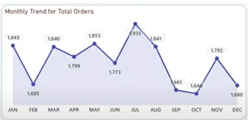
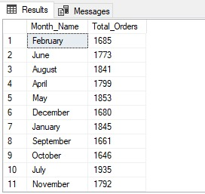
7. Monthly Trend for Orders
Query
Visual
Output
Insight:
This visual is a line chart titled "Monthly Trend for Total Orders" that displays the total number of orders received each month of the year.
Trend Overview:
The number of orders fluctuates throughout the year, with noticeable peaks and troughs.
The highest number of orders is in July at 1.935K.
The lowest number of orders is in October at 1.644K.
Monthly Patterns:
The beginning of the year starts relatively high, then dips in February.
There is a general increase from March to July, peaking in July.
A sharp decline is observed from August to October.
Orders pick up again in November but decline in December.

Slide 12
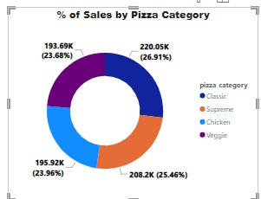
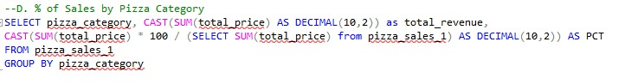
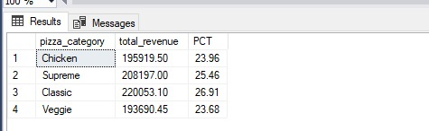
8. D. % of Sales by Pizza Category
Query
Visual
Output
Insight:
This visual is a donut chart titled "% of Sales by Pizza Category" that shows the distribution of sales among different pizza categories. Each segment of the donut chart represents a different category, along with the corresponding sales figures and percentage share.
Category Distribution:
Classic pizzas have the highest sales, accounting for 26.91% of total sales.
Supreme pizzas follow closely, making up 25.46% of the sales.
Chicken pizzas contribute 23.96% to the total sales.
Veggie pizzas have the lowest share, at 23.68%.
Sales Insights
The sales percentages are relatively close, indicating a balanced preference for different pizza categories among customers.
The Classic category leads in popularity, suggesting it may be a favorite among customers..
Supreme and Chicken categories also have significant shares, indicating strong customer interest.
The Veggie category, while the smallest share, still makes up a substantial portion of the sales.

Slide 13
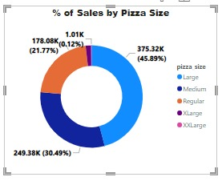
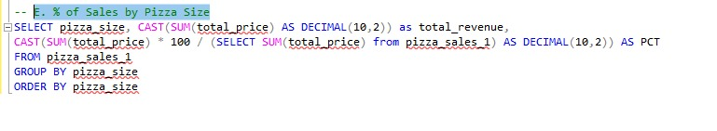
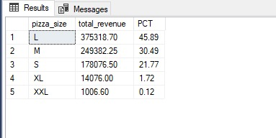
9. E. % of Sales by Pizza Size
Visual
Query
Output
Insight:
This visual is a donut chart titled "% of Sales by Pizza Size" that shows the distribution of sales among different pizza Size. Each segment of the donut chart represents a different Size, along with the corresponding sales figures and percentage share.
Category Distribution:
Large pizzas have the highest sales, accounting for 45.32% of total sales.
Medium pizzas follow closely, making up 30.49% of the sales.
Regular pizzas contribute 21.77% to the total sales.
X-large pizzas have the lowest share, at 1.01%.

Slide 14
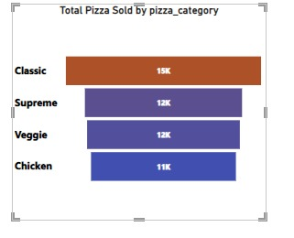
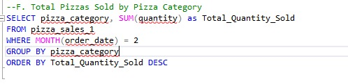
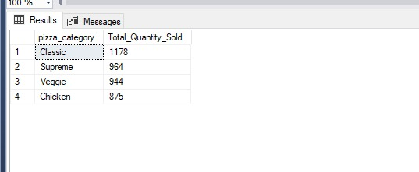
10. Total Pizzas Sold by Pizza Category?
Visual
Query
Output
Insight:
Classic Pizza accounts for the highest sales (14,888 pizzas) followed by Supreme (11,987 pizzas), Veggie (11,649 pizzas) and Chicken (11,050 pizzas).

Slide 15
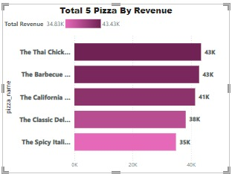
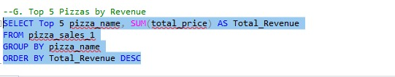
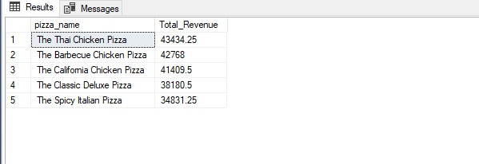
11. Top 5 Pizzas by Revenue
Visual
Query
Insight:
The visual is a horizontal bar chart depicting the total revenue generated by five different types of pizzas.
The bars are colored in a gradient of dark pink to light pink, indicating the revenue values visually. The darkest shade represents the highest revenue (43K), and the lightest shade represents the lowest revenue (35K).
Output

Slide 16
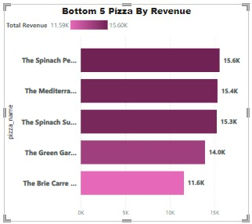
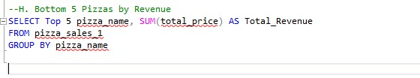
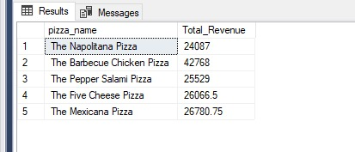
12. Bottom 5 Pizzas by Revenue
Visual
Query
Insight:
The visual is a horizontal bar chart showing the total revenue generated by the bottom five pizzas.
The bars are colored in a gradient of dark pink to light pink, indicating the revenue values visually. The darkest shade represents the highest revenue within this group (15.6K), and the lightest shade represents the lowest revenue (11.6K).
Output

Slide 17
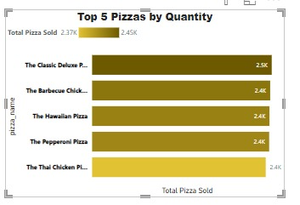
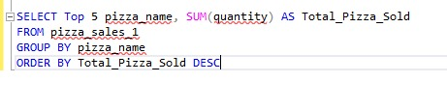
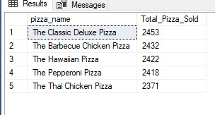
12. Top 5 Pizza By Quantity
Visual
Query
Insight:
The visual is a horizontal bar chart showing the top five pizzas by quantity sold.
The bars are colored in shades of yellow to brown, indicating the quantity values visually. The darkest shade represents the highest quantity sold (2.5K), and the lighter shades represent slightly lower quantities (2.4K).
Output

Slide 18
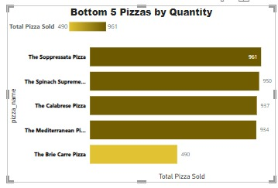
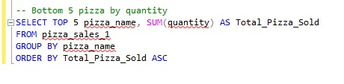
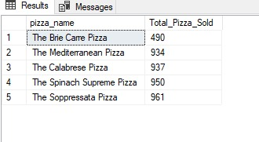
12. Bottom 5 Pizza By Quantity
Visual
Query
Insight:
The visual is a horizontal bar chart showing the total revenue generated by the bottom five pizzas Quantity.
The bars are colored in a gradient of dark yellow to brown, indicating the revenue values visually. The darkest shade represents the highest revenue within this group (961), and the lightest shade represents the lowest revenue (490).
Output

Slide 19
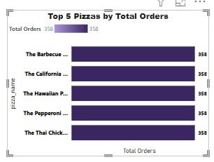
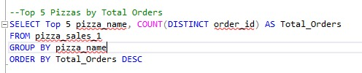
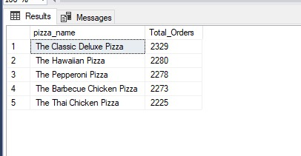
12. Top 5 Pizza By Total Orders
Visual
Query
Insight:
The visual is a horizontal bar chart showing the top five pizzas by quantity Orders.
The bars are colored in shades of Blue to Light Blue, indicating the quantity values visually. The darkest shade represents the highest quantity sold (385), and the lighter shades represent slightly lower quantities (358).
Output

Slide 20
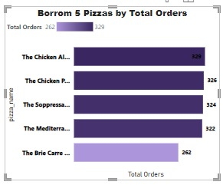
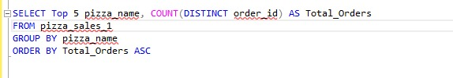
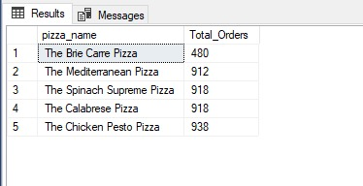
12. Bottom 5 Pizza By Total Orders
Visual
Query
Insight:
The visual is a horizontal bar chart showing the top five pizzas by quantity Orders.
The bars are colored in shades of Blue to Light Blue, indicating the quantity values visually. The darkest shade represents the highest quantity sold (329), and the lighter shades represent slightly lower quantities (262).
Output

Slide 21


